Slide 1
Game Pitch: Hikari no To
Computer Games Laboratory 2017/2018
Team Pick One:
Muhammad Inshal Uddin
Paul Preißner
Jonas Mayer
Artem Bishev
Technical University of Munich
06.11.2017

Slide 2
We decided on a…
Cooperative Dungeon Crawler
Diablo-like gameplay for players, which (almost) everyone loves: run, collect loot, fight enemies
Players have unique abilities and need to cooperate to make their way through procedurally-generated levels
Rogue-like elements to make game shorter, lively and replayable

Slide 3
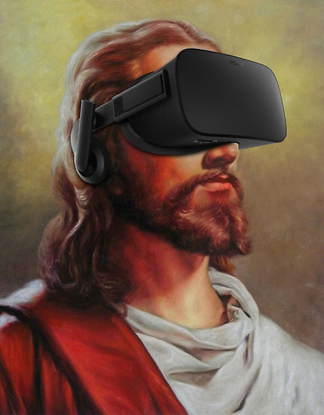
Novel feature: Dungeon Master
Godlike entity in VR
unique set of abilities and different gameplay.
Sees the entire level from a giant’s perspective and guides the players.
redbubble.net

Slide 4
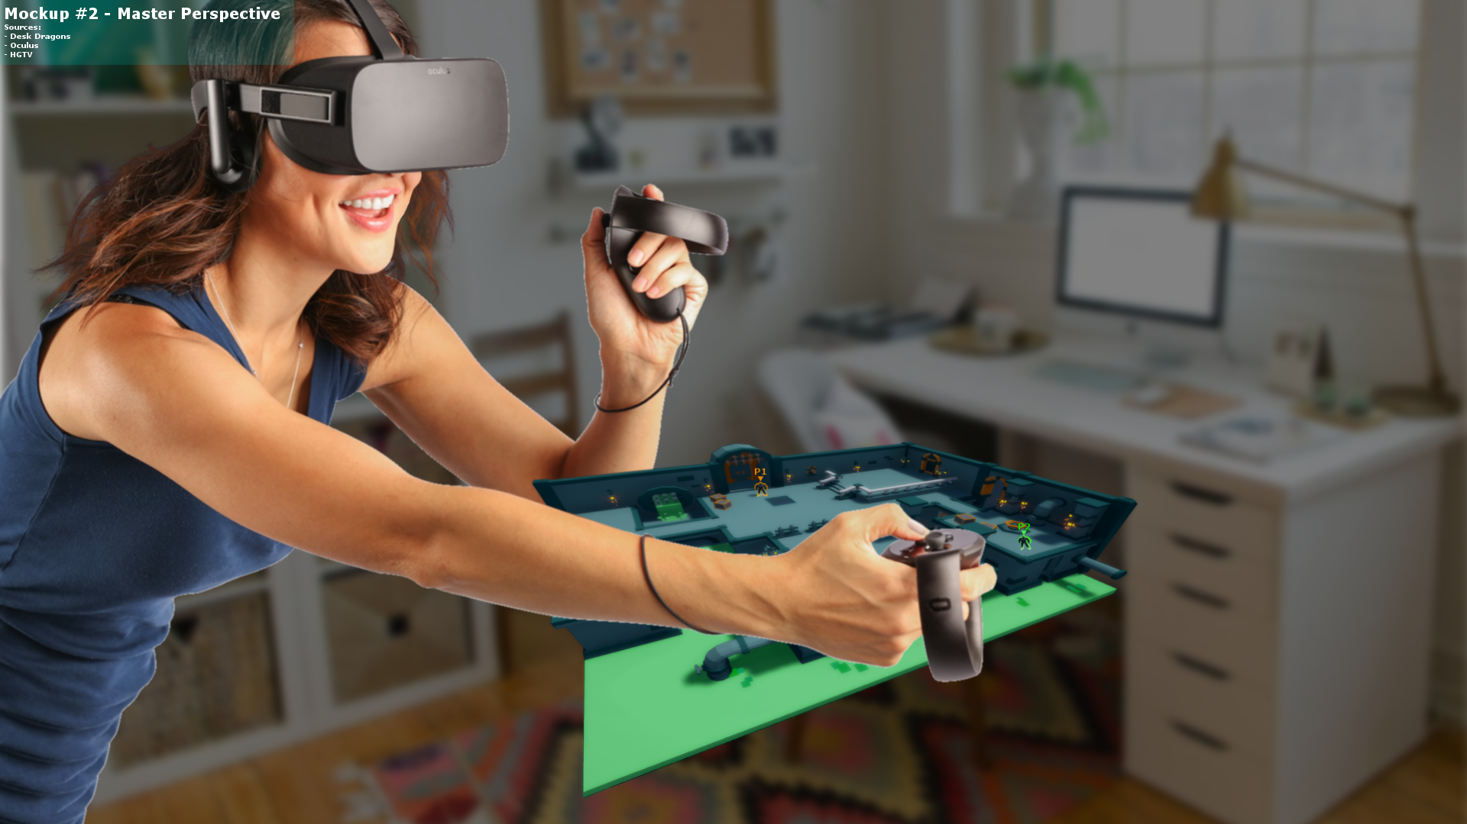
Mockup

Slide 5
Crawler’s gameplay – Diablo/Orcs must die
Character on the ground
Run through the level, kill monsters, gather loot
Only sees immediate surroundings
Can die, but are the only entities able to complete a dungeon
Different classes have different abilities
Need to effectively communicate with the master to reach their goals
Have a limited skillset confined to their immediate surroundings, cannot spot distant traps, cannot alter the dungeon

Slide 6
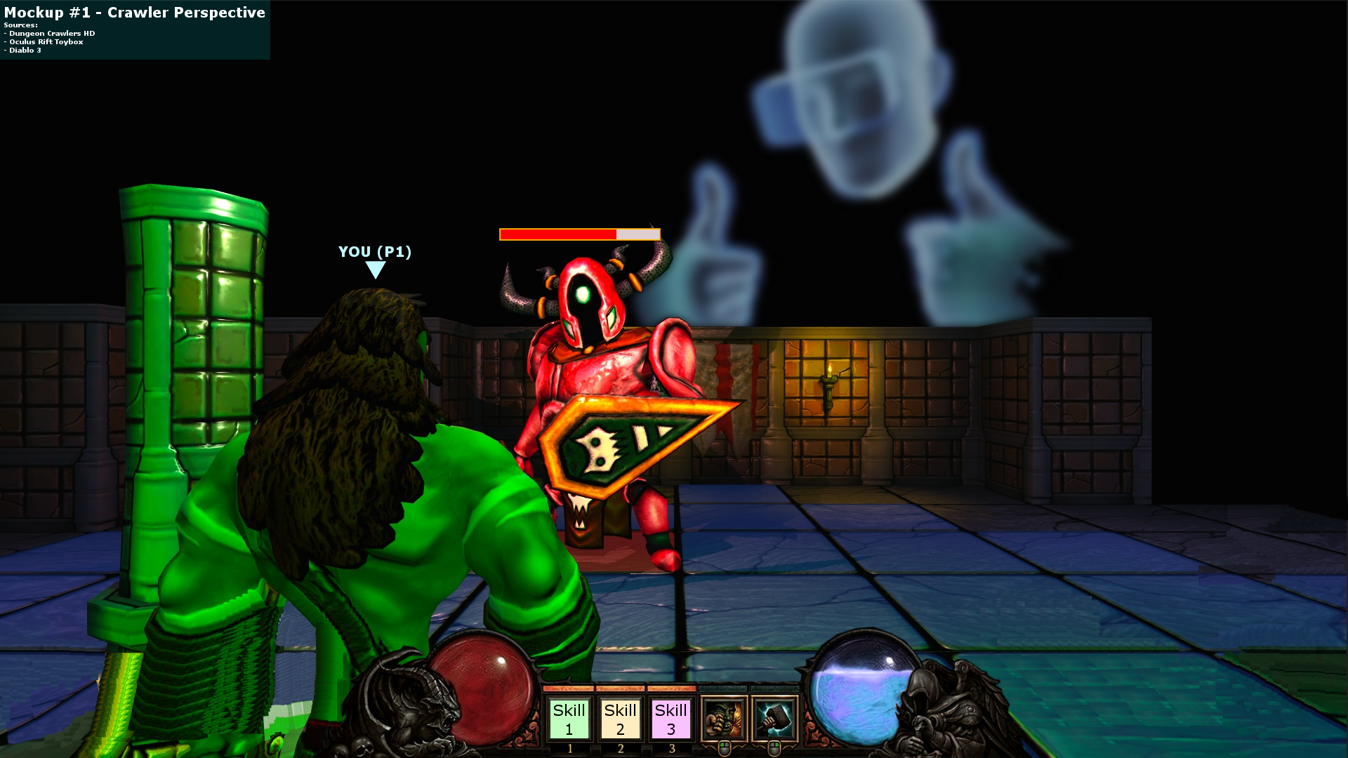
Mockup

Slide 7
Master’s gameplay – Dungeon Keeper
VR player, overlooks dungeon from above, can lean in to focus on areas of interest
Guides the crawlers, helps them survive and find each other
unique set of abilities that allows them to alter the dungeon structure, buff the crawlers, debuff/damage enemies
shares information, needs to warn crawlers about danger, show them way through the level
limited, but rechargeable resources
-> challenging micromanagement!

Slide 8
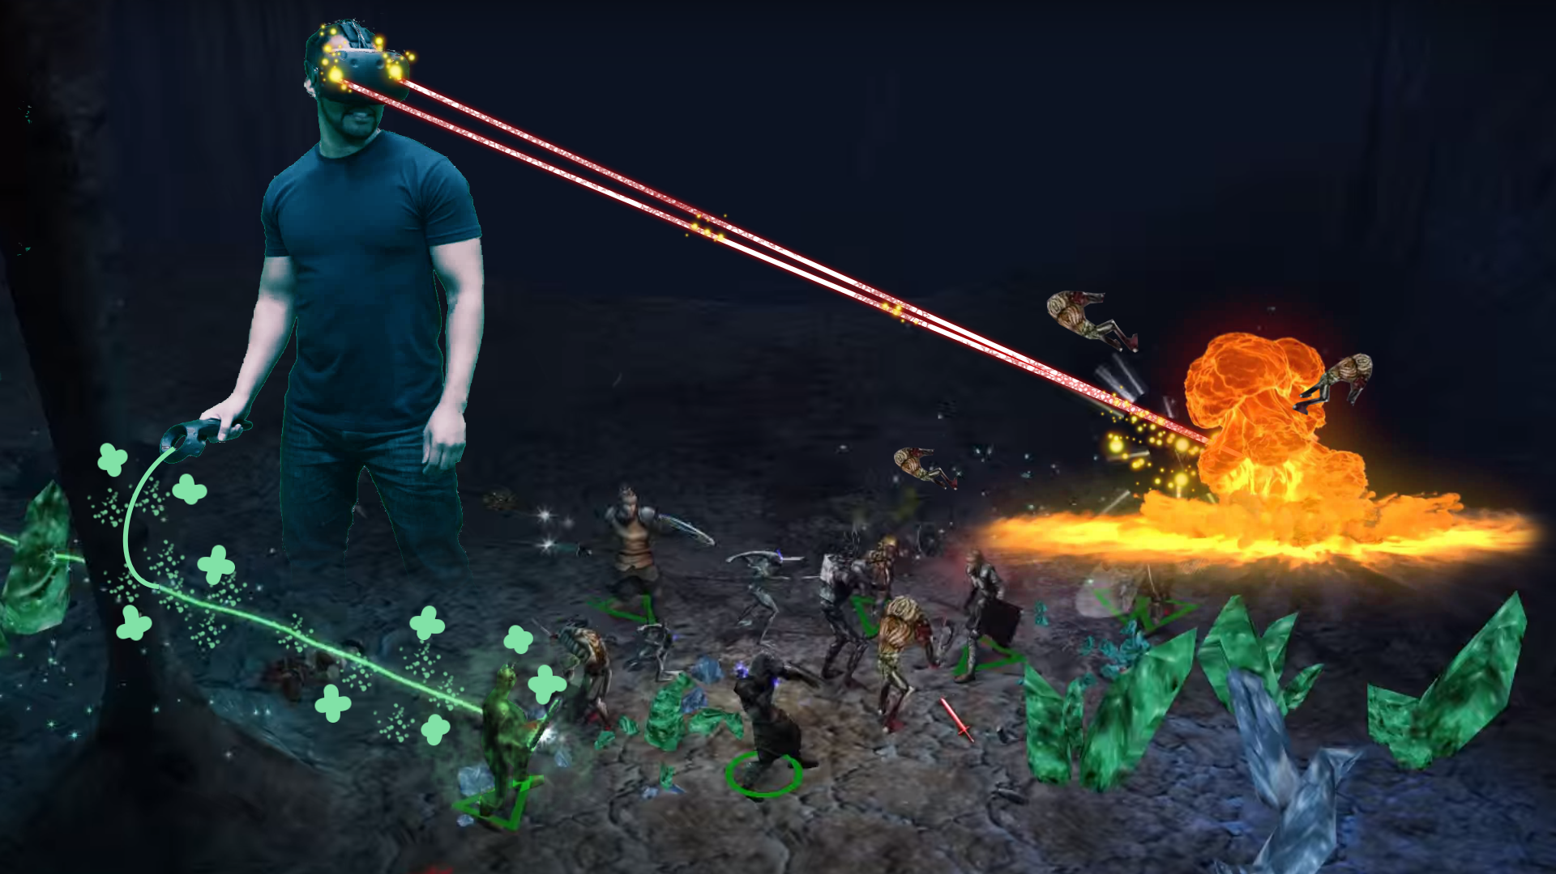
Mockup

Slide 9
Together
Our game is primarily about cooperation
Cooperation between the crawlers
Boss battles/tough enemies nigh impossible solo
Augment each other’s skills
Cooperation between each crawler and the master
Guidance to goal (dungeon not inherently fair to crawler,
Support in battle
Feedback
Otherwise high likelihood of failure

Slide 10
Game setting
We have a dungeon crawler, but to give it a twist we have a modern setting: Asian metropolis full of neon lights, dungeons are the levels of a shady organization’s headquarters
What’s the backstory, the plot?
Players go up the levels of a fortified high-rise tower in order to rescue their friend from a rivalling clan,
who’s being kept for their supernatural powers and unable to escape by themselves, so uses their powers to guide and support the group on their way up

Slide 11
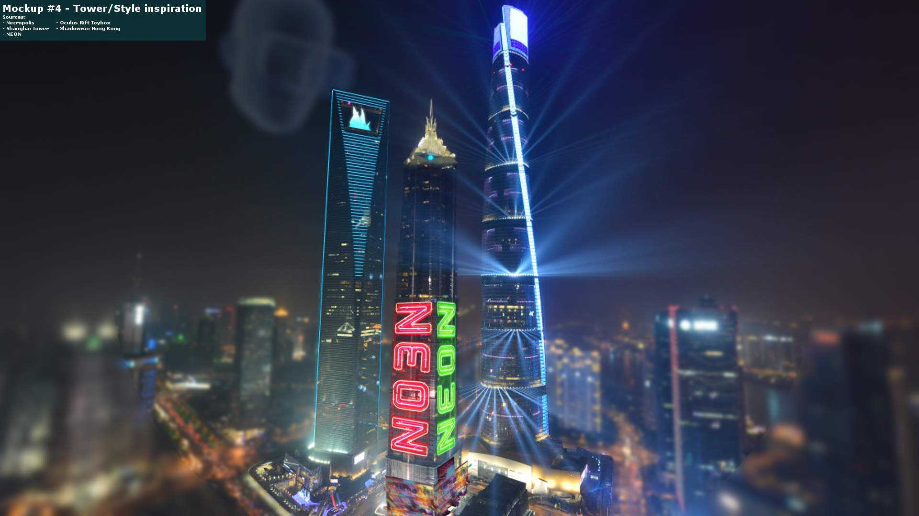

Slide 12

Inspiration: Downtown

Slide 13
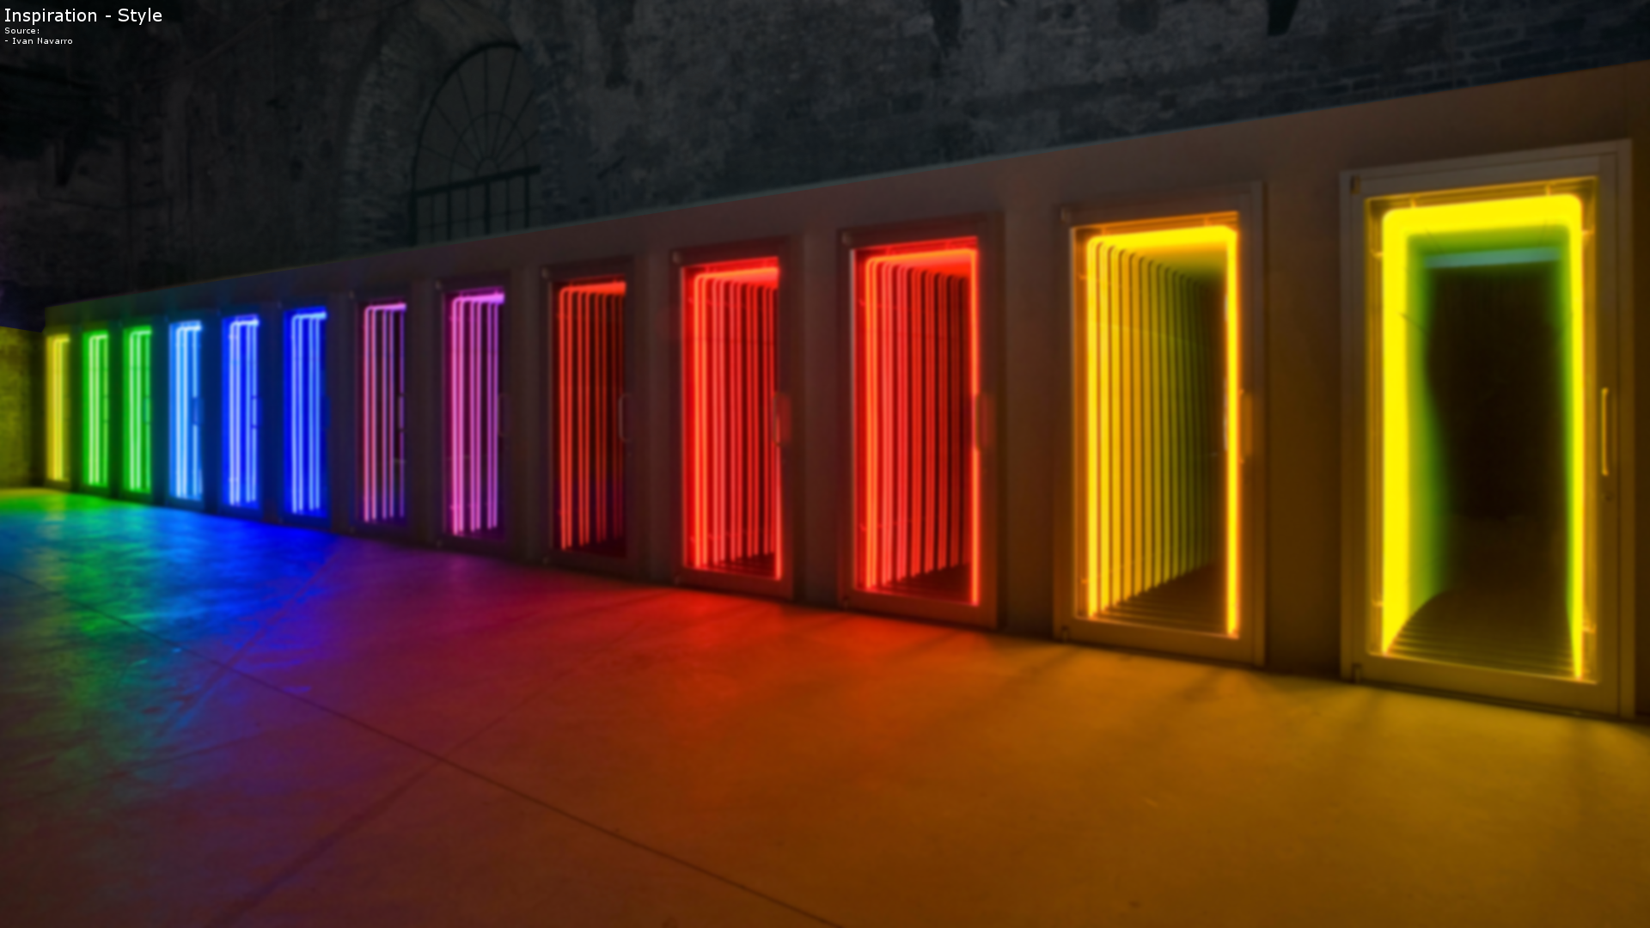
Inspiration: Neon Lights and Colors

Slide 14
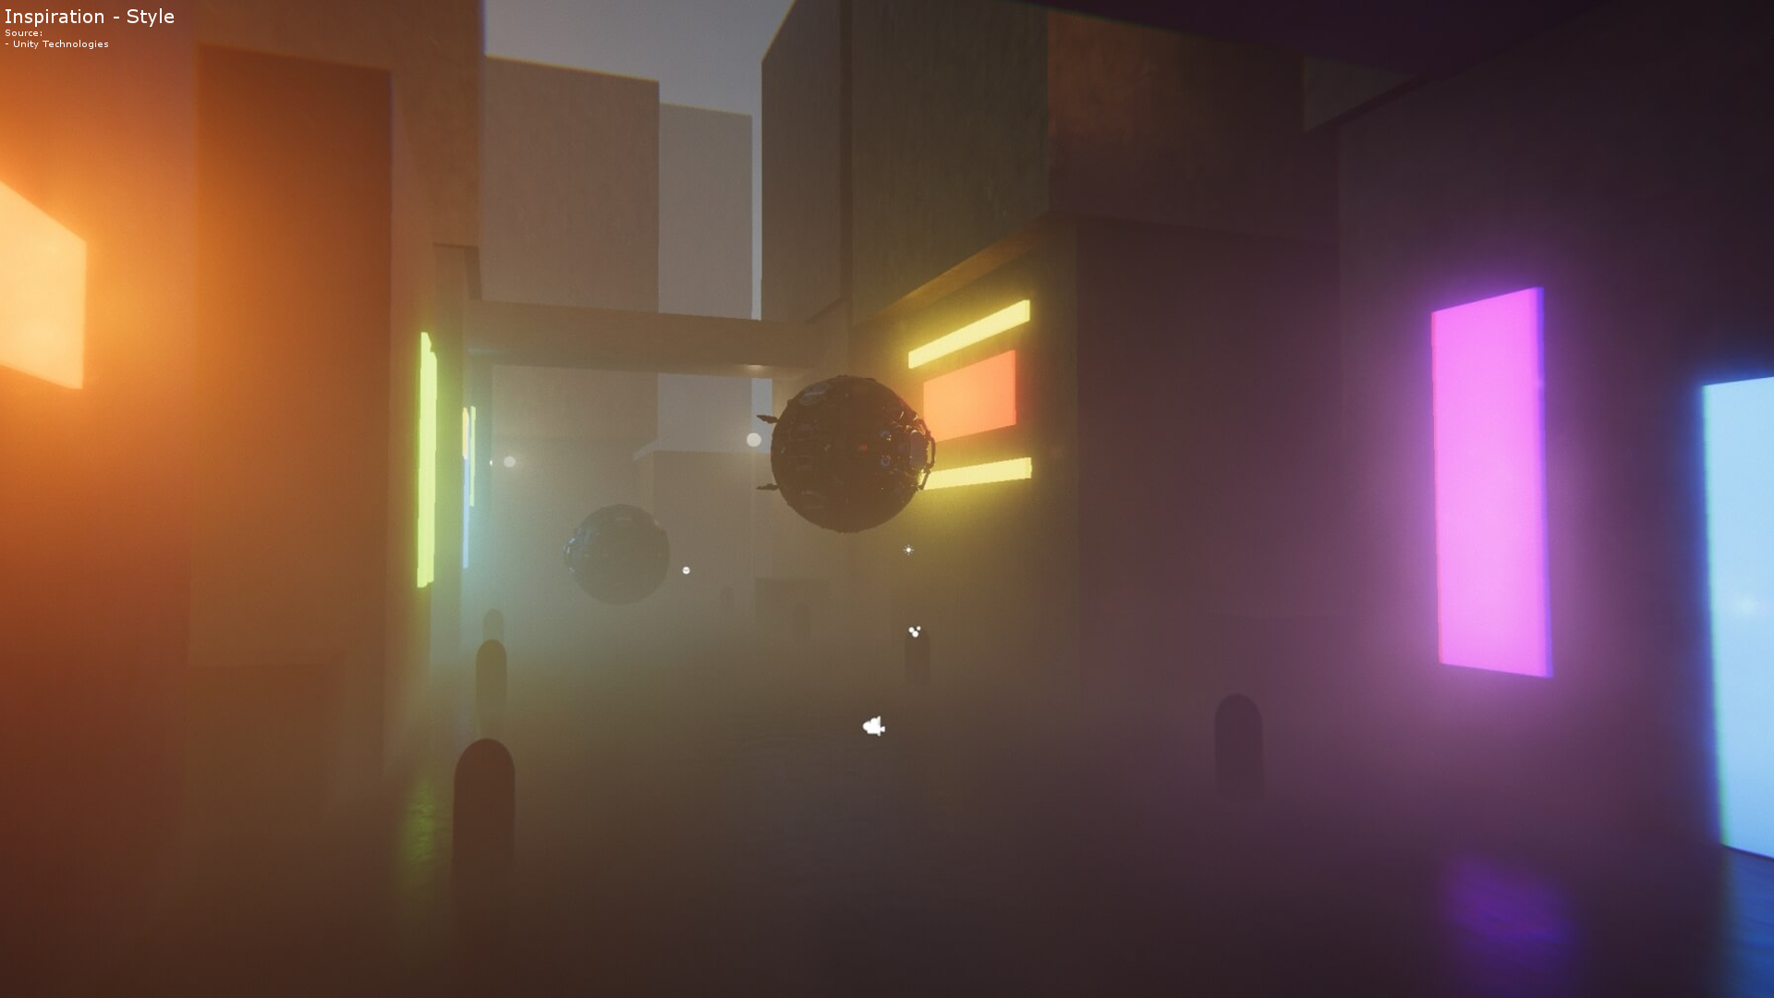
Inspiration: Simplistic Style

Slide 15
Technical details
Crawlers: PC, traditional setup with monitor/mouse/keyboard
Master: PC, using VR headset and tracked motion controllers
Game is created in Unity3D
Stable networking
Procedural generation for enjoyable levels
Simplified visuals to lower artistic effort

Slide 16
Challenges
Visually homogenous style
Game balance
promote teamwork, but don’t cheaply enforce it
Achieve diverse experiences for new playthroughs
ambitious technical backbone
networking
procedural generation
VR hand tracking

Slide 17
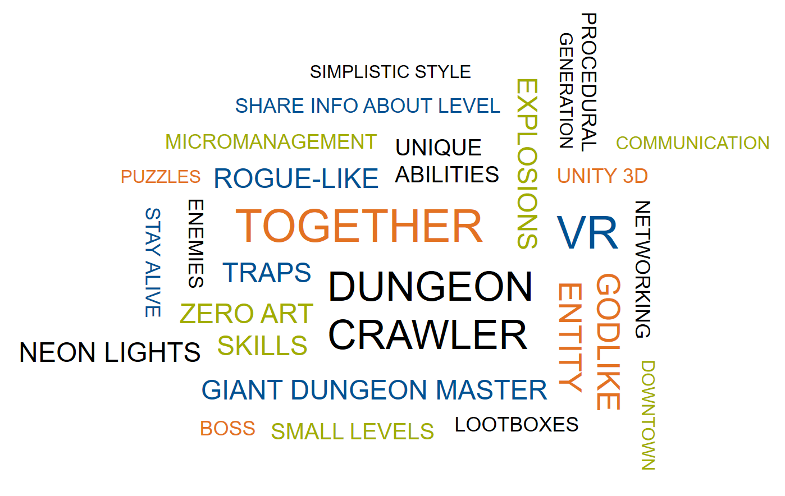
Q&A

